Slide 1
Module: Develop Enterprise Applications Qualification: Professional Diploma in Web Development
Introduction to Spring Boot
By the end of this tutorial you will be able to understand the basics of Spring Boot.

Slide 2
Contents
S. No. | Topic Description | Required / Optional
01 |  | Required
03 |  | Required
04 |  | Required
05 |  | Required
06 |  | Required
07 |  | Required
08 |  | Required
09 |  | Required
10 |  | Required

Slide 3
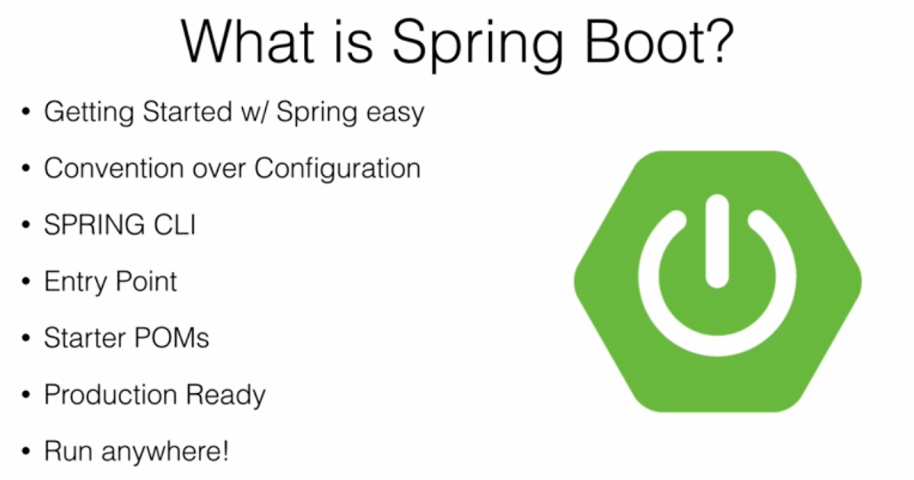
Spring Boot
Spring boot is a Spring framework which provides RAD (Rapid Application Deveolopement) feature to the Spring framework.
It is highly dependent on the starter poms feature which is very powerful and works flawlessly.
It helps you build, package and deploy the Spring application with minimal or absolutely no configurations.

Slide 4
Features of Spring Boot
Create stand-alone runnable jar applications
Embedded Tomcat, Jetty or Undertow directly (no need to deploy WAR files)
Designed for containerization and micro-services architecture.
Provide opinionated 'starter' dependencies to simplify your build configuration
Minimal configuration via auto-configuration.
Automatically configure Spring and 3rd party libraries whenever possible
Provide production-ready features such as metrics, health checks and externalized configuration
Absolutely no code generation and no requirement for XML configuration

Slide 5
System Requirements
Spring Boot 2.1.6.RELEASE requires Java 8 and is compatible up to Java 11 (included).
Spring Framework 5.1.8.RELEASE or above is also required.
Explicit build support is provided for the following build tools:
Spring Boot supports the following embedded servlet containers:
Build Tool | Version
Maven | 3.3+
Gradle | 4.4+
Name | Servlet Version
Tomcat 9.0 | 4.0
Jetty 9.4 | 3.1
Undertow 2.0 | 4.0

Slide 6
Installation Instruction
You can use Spring Boot in the same way as any standard Java library.
Include the appropriate spring-boot-*.jar files on your classpath.
Spring Boot does not require any special tools integration, so you can use any IDE or text editor.
You can run and debug a Spring Boot application as you would any other Java program.
You could copy Spring Boot jars
Recommend that you use a build tool that supports dependency management (such as Maven or Gradle).

Slide 7
Notable Features of Spring Boot
Quick Start:
Spring Boot makes it easy to create stand-alone, production-grade Spring based Applications that you can "just run".
Auto-configuration:
Sets up your application based on the surrounding environment, as well as hints what the developers provide.
Standalone:
It's completely standalone. Hence, you don’t need to deploy your application to a web server or any special environment. Your only task is to click on the button or give out the run command, and it will start.
Opinionated:
This means that the framework chooses how to do things for itself. This is the point where a lot of people says "wait a minute, I do not want to participate in it."
Here I encourage you to wait for a second and hold your judgment for now, because, actually, it can be a good thing.

Slide 8
Quick Start
Spring Boot allows you to quickly start your development, without any configuration.
First you need to create a Spring Boot project using Spring Initializr.
Then you can add properties in application.properties if needed.
And you can right away start creating your application classes and writing business logic code.
You don't need to do any configuration or implementation to setup a Spring Boot application, it is automatically configured due to starter POMs and auto-configuration.
If you have spring-boot-starter-web in your dependency, it will also come with embedded Tomcat server to host your application on port 8080.
You don't need to build a war, running the executable jar will host your application on port 8080.

Slide 9
Spring Boot Starters
Spring Boot provides a number of “Starters” that lets you add dependency jars to your classpath. You add these starters as dependency in your project's pom.xml.
You don't need to mention versions of the dependency starters as they are automatically managed by the parent starter version.
Our application will use spring-boot-starter-parent as a parent starter, while few child starter projects too.
Each single starter dependency adds multiple dependency jars to the classpath dependening on which starter we are adding.
For e.g. if we add spring-boot-starter-web starter in pom, it will add following jars to classpath:
spring-web, spring-webmvc
hibernate-validator
spring-boot-starter-tomcat
spring-boot-starter-json

Slide 10
Auto-configuration - 1
In Spring Boot, you don't need to configure a component scan, dispatcher servlet, view resolver, web JARs, etc. using xml or @Configuration classes.
Spring boot is smart enough to configure your Application Context based on the dependency jars present on your class path.
For example, if HSQLDB is on your classpath, and you have not manually configured any database connection beans, then Spring Boot auto-configures an in-memory database.
If you have spring-boot-starter-web as your dependency, Spring Boot will autoconfigure a dispatcher servlet, unlike SpringMVC framework.
It will also know to register your @Controller or @RestController Beans and their various Request Mappings automatically, due to spring-boot-starter-web.
You also don't need to manually configure a Logger in Spring Boot application or add any of its dependencies. It comes by default with Spring Boot and you just need to get instances of Logger in each class using LogFactory, like you would do in other applications.
Spring Boot will also scan all the components present at same or child level packages of the class contaning @SpringBootApplication.
Alternatively, you can also mention the custom path for component scan as: @SpringBootApplication(scanBasePackages = "com.lithan.sb")

Slide 11
Auto-configuration - 2
You need to opt-in to auto-configuration by adding the @EnableAutoConfiguration or @SpringBootApplication annotations to one of your @Configuration classes.
Auto-configuration is non-invasive. It gets out of your way for specific parts of configuration which you want to customize in order to meet your needs.
For example, if you add your own DataSource bean, the default embedded database support backs away.
You can also exclude a particular Auto Configuration as per your need. Following snippet shows a way to exclude Spring Security Auto Configuration:
@EnableAutoConfiguration(exclude = SecurityAutoConfiguration.class)

Slide 12
Difference Between Spring & Spring Boot
Basis | Spring | Spring Boot
Configuration | To design any spring based application, a developer needs to be taken care on manual set up on Hibernate data source, Entity Manager, Session Factory, Transaction Management everything. | To Design all those common set up, a developer doesn’t need to define everything individually, SpringBootConfiguration annotation enough to manage everything at the time of deployment.
XML | Spring MVC application some of the XML definition mandatory to manage. | Configuring Spring Boot Application nothing needs to be managed, the only annotation managed everything.
Controlling | As configuration can be easily handled by manually, so Spring or Spring MVC can manage to not loading some of the unwanted default features for that specific application. | In case of Spring Boot, it automatically handled on default loading part, so the developer doesn’t have as such concept of not loading some of the specific unusable spring default features.
Use | Better to use if application type or characteristics are purely defined. | Better to use where application type of functionality for future use not properly defined. As integrating any Spring specific feature will be auto-configured in here, so no need any additional configuration.

Slide 13
Spring vs. Spring Boot
Spring Framework
Spring Boot
Light-weight POJO based approach instead of EJBs.
Suitable for Service-Oriented Architecture
Manual Configuration
Need to manage dependencies manually
Dependency versions needs to be compatible.
XML and Annotation based configurations
Runnable Jar and embedded Tomcat based approach.
Suitable for Micro-Service Architecture.
Auto-Configuration
Starter POMs manage dependencies.
Dependency versions are managed automatically.
Purely Annotation based minimal configuration.

Slide 14
Practical Objectives
Create “Hello World” Spring Boot Application
Create Application having REST APIs in Spring Boot which allows end-user to perform following tasks:
Register themselves to our Application Platform.
See the list and details of all users
Update and delete their details.
Generate API Documentation using Swagger.
Our application will mainly have three tables: User, Address and Role.
We will interact with our application using POSTMAN as REST Client.

Slide 15
Spring Initializr
Spring Initializr is project by Spring Community which allows us to create Spring Boot project's basic structure.
It is hosted on https://start.spring.io as a simple web UI. We can select following settings from UI:
If we want a Maven project or a Gradle project
Language of the project - Java, Kotlin and Groovy are possible options.
Version of Spring Boot Parent Release.
Project meta-data like Group Id, Artifact Id, etc.
We can also select all the Spring Boot supported dependencies we need from our application from this web UI itself.
Once we have selected all the information, we can generate the Spring Boot project and it will be downloaded as a zip.
Spring Initializr is also integrated with Spring Tools Suite and latest versions of Eclipse IDEs so that we can select all the metadata from IDE itself in order to create a Spring Boot project.
Next, we will create a Spring Boot project using Spring Initializr hosted by https://start.spring.io/

Slide 16
Project Setup Steps
Create project from Spring Initializer as shown below slides
Configure your IDE (Spring Tools Suite or Eclipse) for Lombok
Start the IDE and import the starter project created in 1st step. File -> Import -> Existing Maven Project
Examine the directory structure of project and following files:
pom.xml
Application.java (it may be AppApplication.java or something else)
application.properties

Slide 17
Step 1
Creating project using Spring Initializr

Slide 18
Spring Intializr - Dependencies
We need to search and add following dependencies from Spring Initializr Web UI:
Spring Web Starter
MySql Driver
Lombok
Spring Data JPA - We will not add this dependency from Spring Initializr UI, but will add it manually in pom later, once we add database properties to application.properties.

Slide 19
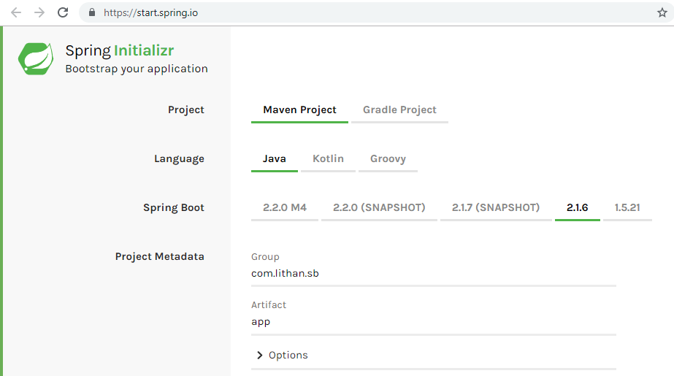
Spring Initializr - Basic Configuration

Slide 20
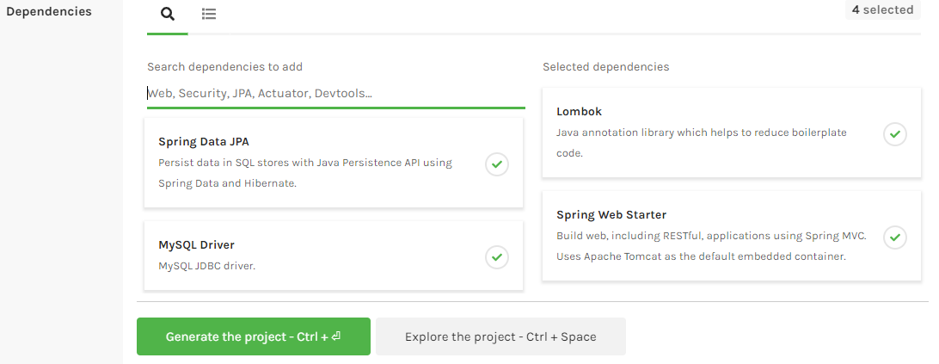
Spring Initializr - Dependency Management
Once you generate the project from Spring Initializr, you will receive the basic project structure in archive format (zip or tar).
You can extract it and import as a maven project.

Slide 21
Step 2
Configure your IDE for Lombok

Slide 22
Lombok
Project Lombok is a java library that automatically plugs into your IDE and helps you reduce boiler plate Java specific code.
Never write another getter or equals method again, with one annotation your class has a fully featured builder, automate your logging variables, and much more.
We will use Lombok mainly for @Data and @Value annotations.
@Data will generate getter method for all the fields and setter methods for non-final fields. It also generates meaningful toString, hashCode and equals implementations. Will also generate All Arguments Constructor.
@Value makes the class immutable by making all the elements final, generating getters, All Arguments Constructor, toString, hashCode and Equal method for the class.

Slide 23
Lombok Setup Steps
You need to first download the lombok.jar from it's official site and open it.
The jar will try to find Eclipse or Spring Tools Suit in your system.
If your IDE cannot be found, you can manually specify the location.
After that, you need to click on Install / Update and complete the installation process.
Further information can be found here: https://projectlombok.org/setup/eclipse

Slide 24
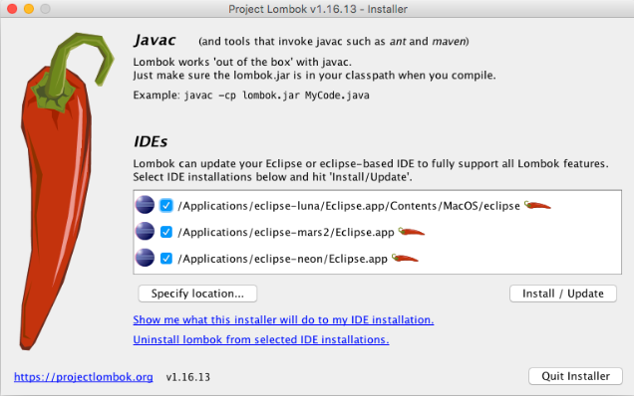
Lombok Setup

Slide 25
Step 3
Import maven project created from Spring Initializr

Slide 26
Import Maven Project - Steps
Start your IDE after you have setup Lombok.
Then Click on File -> Import.
Type Maven in “Select an import wizard”.
Then select “Existing Maven Projects” and click on next.
Dialouge box will occur where you can browse to the location where your Spring Initializr created project is present.
Select the project and import it by clicking on Finish.

Slide 27
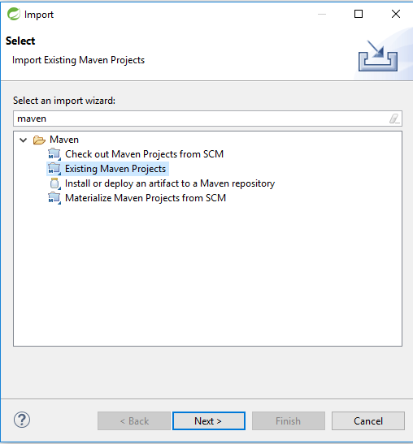
Import Maven Project

Slide 28
Import Maven Project

Slide 29
Step 4
Examine the directory structure of project

Slide 30
Let's examine:
pom.xml - Maven Configuration

Slide 31
pom.xml - Project Object Model
Our pom.xml will leverage a parent project as spring-boot-starter-parent. The parent pom will have version 2.1.3 or 2.1.6.
We have starter pom spring-boot-starter-web as a dependency which supports the development of SpringMVC and Spring REST Applications.
As you will see in pom.xml, we will not mention versions of dependencies like spring-boot-starter-web. This is because Spring Boot automatically matches the compatible versions of child starter dependencies based on the parent starter version.
Next we have spring-boot-starter-data-jpa for the support of Java Persistence Api and Hibernate as ORM tool. This JPA starter has features of Spring Data like JpaRepository and CrudRepository, which will see in this tutorial later.
As we want to use MySQL as database for our application, we will use mysql-connector-java.
Lastly, we use spring-boot-starter-test for Junit testing and lombok to reduce boilerplate code of POJOs like Getters, Setters, Constructors, etc.

Slide 32
pom.xml - Code
<?xml version="1.0" encoding="UTF-8"?>
<project xmlns="http://maven.apache.org/POM/4.0.0" xmlns:xsi="http://www.w3.org/2001/XMLSchema-instance"
xsi:schemaLocation="http://maven.apache.org/POM/4.0.0 http://maven.apache.org/xsd/maven-4.0.0.xsd">
<modelVersion>4.0.0</modelVersion>
<parent>
<groupId>org.springframework.boot</groupId>
<artifactId>spring-boot-starter-parent</artifactId>
<version>2.1.3.RELEASE</version>
<relativePath /> <!-- lookup parent from repository -->
</parent>
<groupId>com.lithan.sb</groupId>
<artifactId>app</artifactId>
<version>0.0.1-SNAPSHOT</version>
<properties>
<java.version>1.8</java.version>
</properties>
<!-- Maven Dependencies, Build Configuration and other pom specific code goes here -->
</project>

Slide 33
pom.xml - Building executable jar
Executable jars (sometimes called “fat jars”) are archives containing your compiled classes along with all of the jar dependencies that your code needs to run.
To create an executable jar, we need to add the spring-boot-maven-plugin to our pom.xml. To do so, insert the following lines just below the dependencies section:
<build>
<plugins>
<plugin>
<groupId>org.springframework.boot</groupId>
<artifactId>spring-boot-maven-plugin</artifactId>
</plugin>
</plugins>
</build>

Slide 34
pom.xml - Dependencies
<dependencies>
<dependency>
<groupId>org.springframework.boot</groupId>
<artifactId>spring-boot-starter-web</artifactId>
</dependency>
<dependency>
<groupId>mysql</groupId>
<artifactId>mysql-connector-java</artifactId>
</dependency>
<dependency>
<groupId>org.projectlombok</groupId>
<artifactId>lombok</artifactId>
</dependency>
<dependency>
<groupId>org.springframework.boot</groupId>
<artifactId>spring-boot-starter-test</artifactId>
<scope>test</scope>
</dependency>
</dependencies>

Slide 35
Fixing Version Error - Only if needed!
If your IDE is not updated, you may see error in your IDE after you import the Spring Boot project downloaded from Spring Initializr site i.e. http://start.spring.io
To fix this, you need to reduce the Spring Boot parent starter version from 2.1.6.RELEASE to 2.1.3.RELEASE.
Then, you need to update your maven project so that updated dependencies gets downloaded to your system.
To update your maven project:
Right click on your project -> Maven -> Update Project
In “Update Project” dialouge box, select your project and then mark “Force Update of Snapshots/Releases” as true.
Click on Okay and then the error should get resolved.
The screenshot for fixing version error is shown in next slides which demonstrates above mentioned steps.

Slide 36
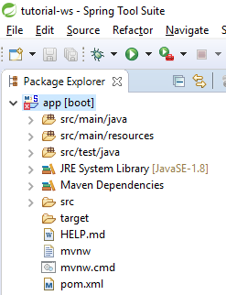
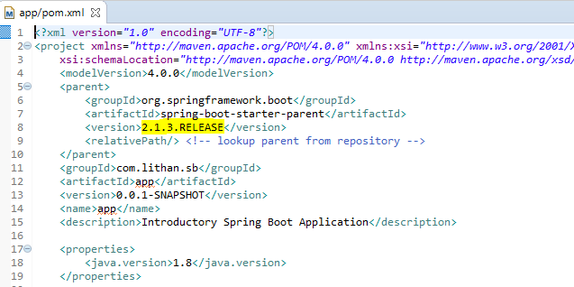
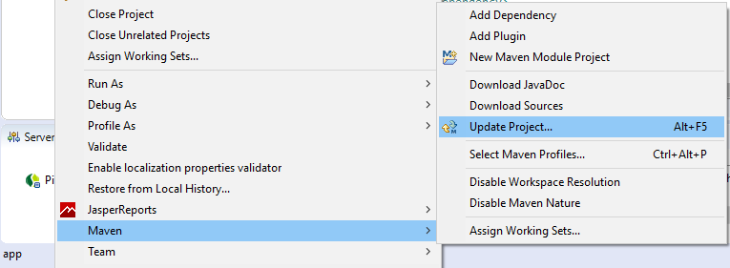
Fixing Version Error - Only if needed!
1
2
3

Slide 37
Let's examine:
Application.java

Slide 38
Application.java
@SpringBootApplication
@RestController
public class Application {
@RequestMapping("/")
String home(@RequestParam(required = false) String name) {
if(name!=null) {
return "Hello "+name+" World!";
}else {
return "Hello World!";
}
}
public static void main(String[] args) {
SpringApplication.run(Application.class, args);
}
}

Slide 39
@SpringBootApplication
Although there is not much code in Application.java, quite a lot is going on and we will explore it.
Let's start with @SpringBootApplication annotation which enables the auto-configuration feature and tells JVM the entry point of Spring Boot Application.
This annotation encapsulates the working of three different annotations:
@Configuration: Allows the developers to explicitly register the beans for custom configurations.
@ComponentScan: Enables the component-scanning so that the stereotype and other components will be automatically discovered and registered as beans in spring’s application context.
@EnableAutoConfiguration: This annotation tells Spring Boot to “guess” how you want to configure Spring, based on the jar dependencies that you have added. For e.g., if you have spring-boot-starter-web added Tomcat and Spring MVC, the auto-configuration assumes that you are developing a web application and sets up Spring accordingly.

Slide 40
@RestController & @RequestMapping
@RestController is a stereotype annotation which tells spring to register this class as Rest Controller and to handle incoming web requests.
The @RequestMapping annotation provides “routing” information. It tells Spring that any HTTP request with the / path should be mapped to the home method.
The @RestController and @RequestMapping annotations are Spring MVC annotations. (They are not specific to Spring Boot.)

Slide 41
The “main” method
The final part of our application is the main method. This is just a standard method that follows the Java convention for an application entry point.
Our main method delegates to Spring Boot’s SpringApplication class by calling SpringApplication.run method. SpringApplication class bootstraps our application, starting Spring, which, in turn, starts the auto-configured Tomcat web server if spring-boot-starter-web is added to our pom.xml.
We need to pass Application.class as an argument to the run method to tell SpringApplication which is the primary Spring component. The args array is also passed through to expose any command-line arguments.
The run method returns ConfigurableApplicationContext, if we want to access the context and do any manual bean instantiation or configuration.
SpringApplication.run(Application.class, args)

Slide 42
Running Spring Boot Application
You need to first build the jar in maven using the command mvn clean install.
Then you can run the jar using command as follow:
java -jar target/app-0.0.1-SNAPSHOT.jar
Alternatively, you can run your application directly from IDE as well.
Once your application is started, you can access the default rest point by hitting http://localhost:8080/ from your web browser.
You can also try passing the GET request parameter “name” as: http://localhost:8080/?name=Daniel
As you can see here, with just a single file, we were able to create a REST Endpoint and serve it on port 8080 via embedded tomcat.
Alternatively, there is also a spring-boot maven goal we can execute as follows:
mvn spring-boot:run

Slide 43
Let's add properties to:
application.properties

Slide 44
Add fields to application.properties
We want to use MySQL as our Database so we will create a Schema in it and mention it's name in application.properties file.
For tutorial purposes, we will use the schema name “sb” which stands for Spring-Boot.
We need to update application.properties to point to our MySQL instance on localhost. This is done using following 3 properties:
spring.datasource.url=jdbc:mysql://localhost:3306/sb
spring.datasource.username=root
spring.datasource.password=root
The JPA property spring.jpa.hibernate.ddl-auto=update ensures that Tables in Schema are automatically created/updated in case of changes in our Java Domain Objects.
We are also enabling “show_sql” and “format_sql” property to see Hibernate generated queries in a well formatted manner using following properties:
spring.jpa.properties.hibernate.show_sql=true
spring.jpa.properties.hibernate.format_sql=true

Slide 45
Add Spring Data JPA dependency to pom
As mentioned earlier, now that we have added the MySql configuration properties in application.properties, we can add Spring Data JPA dependency to our pom.xml
This can be achieved by adding following code snippet inside <depdendencies></depdendencies> tag:
<dependency>
<groupId>org.springframework.boot</groupId>
<artifactId>spring-boot-starter-data-jpa</artifactId>
</dependency>

Slide 46
User Registration Application

Slide 47
User Registration Application
Next, we want to extend our application and create REST End-Points such that end-user can register themselves with basic details to our system and can also view details of all users.
We also want to provide end-points to update and delete user details.
First step to extend our application would be to think about how we want to store our user's information in Database.
For this purpose, we will have 3 tables in our database: User, Address and Role. For this, we don't need to create tables in database, Hibernate and JPA will auto-create it because of @Entity annotation and property spring.jpa.hibernate.ddl-auto=update.
We will then start developing Models, Dtos, Persistence Layer, Service Layer and eventually Controller Layer.
We want to have our tables as shown in next slide and we will design our model classes accordingly.

Slide 48
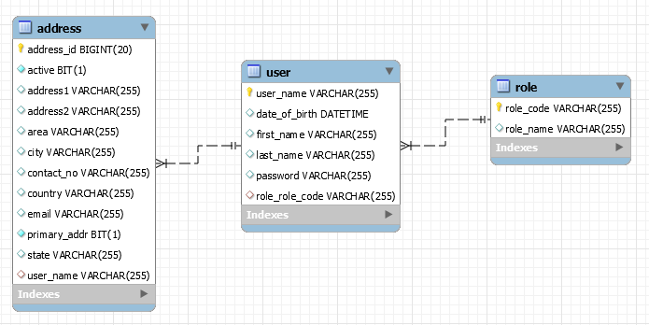
Schema Design

Slide 49
Application Layers
Lets see how our application will be structured in various packages.
Model - Contains Java Domain Objects
User.java, Address.java and Role.java
Dto - Contains Data Transfer Objects
UserDto.java, AddressDto.java, RegistrationFormDto.java
Projection - Contains Projection Interfaces as alternative to Dtos.
AddressProjection.java
Repository - Jpa Interfaces and Implementations for Persistence Layer
UserRepository.java, AddressRepository.java, RoleRepository.java
Service - Business Logic Implementation and Transaction Management.
UserService.java
Controller - REST Controllers for various API end-points.
UserController.java
Constants - Interfaces containing constant values as best practice.
GlobalConstants.java
Exceptions - This layer defines all the custom exceptions.
UserNameAlreadyInUseException.java, RoleNotFoundException.java, IncorrectDateFormatException.java

Slide 50
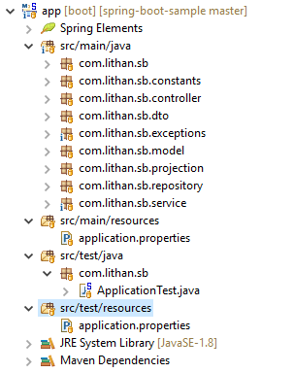
Project Structure

Slide 51
Models (Entities)

Slide 52
Model specific annotations
@Entity annotation defines that a class can be mapped to a table.
@Id annotation is inherited from javax.persistence.Id indicating the member field below is the primary key of current entity .
@GenerateValue annotation is to configure how the primary key should be auto-generated and incremented. It has four generation strategies viz. Auto, Identity, Sequence and Table.
@OneToMany mapping means that one row in current table is mapped to multiple rows in referrencing table.
@ManyToOne mapping means that many rows of current table can be associated with a single row of referrencing table.
@JoinColumn specifies a column for joining an entity association or element collection. If the JoinColumn annotation itself is defaulted, a single join column is assumed and the default values apply.

Slide 53
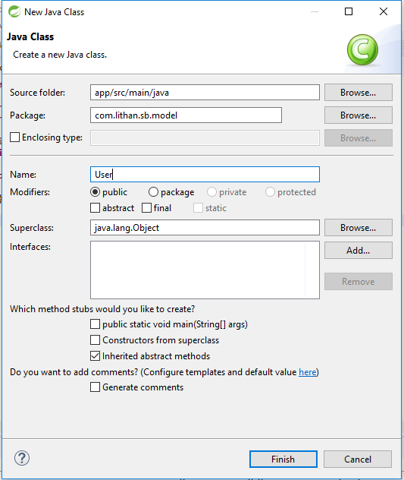
Data Models
The crux of any Enterprise Application lies in it's Data Design.
We start Data Designing by creating User model.
File -> New -> Class
This model will contain basic details of the user.
User model will also have Associations will Address and Role model.

Slide 54
User.java
@Data
@Entity
public class User {
@Id
private String userName;
private String firstName;
private String lastName;
private Date dateOfBirth;
@OneToMany(cascade = CascadeType.ALL,
mappedBy = "user", fetch = FetchType.EAGER)
private List<Address> addressList = new ArrayList<>();
@ManyToOne(fetch = FetchType.EAGER)
private Role role;
}

Slide 55
Role.java
package com.lithan.sb.model;
import javax.persistence.Entity;
import javax.persistence.Id;
import lombok.Data;
@Data
@Entity
public class Role {
@Id
private String roleCode;
private String roleName;
}

Slide 56
Address.java
@Data
@Entity
public class Address {
@Id
@GeneratedValue(strategy = GenerationType.IDENTITY)
private long addressId;
@ManyToOne(cascade = CascadeType.ALL)
@JoinColumn(name = "userName")
private User user;
private String address1, address2, area, city, state, country;
private String contactNo;
private String email;
private boolean active;
private boolean primaryAddr;
}

Slide 57
Dtos and Projections

Slide 58
Dto and Projection
DTO (Data Transfer objects) is a data container for moving data between layers. They are also termed as transfer objects. DTO is only used to pass data and does not contain any business logic. They only have simple setters and getters.
We create DTOs by creating a class and defining variables similar to corresponding entity class. We also provide getter, setter and constructors for a DTO class.
We would use @Data lombok annotation for our DTO classes in order to generate Getters, Setters and Constructor.
Projections are used to create custom views of our models. Through projections, we can create subset of our entities / models.
We create Projections by creating interface and mentioning getter methods of the entity attributes.

Slide 59
RegistrationFormDto & AddressProjection
@Data
public class RegistrationFormDto {
private String userName;
private String firstName;
private String lastName;
private String dateOfBirth;
private long addressId;
private String address1, address2,
private String area, city;
private String state, country;
private String contactNo;
private String email;
private boolean active;
private boolean primaryAddr;
private String roleCode;
}
public interface AddressProjection {
public long getAddressId();
public String getUserFirstName();
public String getUserLastName();
public String getUserUserName();
public String getAddress1();
public String getCity();
public String getState();
public String getCountry();
public String getEmail();
public boolean getActive();
}

Slide 60
Exceptions
Custom Exception Handling Mechanism

Slide 61
Custom Exceptions
We want to cover 3 scenarios where we would like to throw custom exceptions:
The entered User Role is not available in our Role table.
Username is already picked by another user, hence not available.
Date format of a given field is not correct.
RuntimeException is the superclass of those exceptions that can be thrown during the normal operation of the Java Virtual Machine.
RuntimeException and its subclasses are unchecked exceptions which does not need to be declared in throws clause of a method or a constructor.
We will create custom exception classes as follows, which will extend RuntimeException:
RoleNotFoundException.java
UserNameAlreadyInUseException.java
IncorrectDateFormatException.java

Slide 62
Custom Exceptions - 2
Custom Exceptions are mainly specific to business logic and workflow. We can use them as part of validation or to execute certain logic on the occurance of custom exception.
These custom exceptions also helps end-user to understand the error in terms of meaningful business language, which is not the case with Java or Spring specific exceptions.
In order to create custom exception, we have to follow 4 steps:
Create an exception class and extend it with RuntimeException
Add business logic specific variables in the class like a particular ID or information, which we want to expect from the caller.
Override the getMessage() method and create a parameterized constructor for customization of error message.
Throw the Custom Exception from the Handler Class based on business logic requirement.

Slide 63
RoleNotFoundException.java
public class RoleNotFoundException extends RuntimeException{
private String roleCode;
public RoleNotFoundException(String roleCode) {
this.roleCode = roleCode;
}
@Override
public String getMessage() {
StringBuilder sb = new StringBuilder();
sb.append("Role Code: '");
sb.append(this.roleCode);
sb.append("' ");
sb.append("not an acceptable value. ");
sb.append("Acceptable values are: 'Admin', 'User' and 'Moderator'");
return sb.toString();
}
}

Slide 64
Repositories
Persistence Layer

Slide 65
Repositories
Repository is the layer in Web Applications which takes care of talking with Database in order to either retrieve data, or write back the date.
We can create Repositories in Spring Boot by creating Custom Interfaces and extending them with JPA interfaces called JpaRepository or CrudRepository.
Our custom interfaces comes with out-of-the-box methods to perform CRUD operations, as well as we can create custom methods in them without defining them. This can be done by following JPA nomenclature to define repository methods.
If we want to write native SQL and custom implementation of Repository methods, we need to use Spring's @Repository annotation which provides the mechanism for storage, retrieval, search, update and delete operation on objects.
In our example, we will just focus on JpaRepository based interface and not on @Repository based implementations.

Slide 66
UserRepository and AddressRepository
UserRepository.java
public interface UserRepository extends JpaRepository<User, String>{
<T>T findDtoedByUserName(String userName, Class<T> dto);
<T>T findAllDtoedByRoleRoleCode(String roleCode, Class<T> dto);
}
AddressRepository.java
public interface AddressRepository extends JpaRepository<Address, Long>{
<T>List<T> findDtoedByUserUserName(String userName, Class<T> projection);
<T>List<T> findProjectedByUserUserName(String userName, Class<T> projection);
}

Slide 67
Service
Business Logic Layer

Slide 68
Service Layer
This layer is the crux for business logic and it will contain the service classes and service methods holding all the business logic related to our application.
We use the stereotype annotation @Service to denote a class to be a service class.
Service layer receives method call from Controller layer and processes the service request. A single service request ideally would correspond to a single functionality of real-world business requirement.
A single service method may call one or more repository methods in order to perform a single function. Transaction management will be taken care by this layer using @Transactional annotation.
We would ideally want to either commit or roll-back all the repository operations done in a single service method i.e. single functional method.

Slide 69
Service Layer
We will create a single UserService.java class and annotate it with @Service annotation.
As mentioned earlier, our single service method can have calls to multiple repository methods.
We want to create service methods for following functionalities:
Register a user
Update details of the user
View details of the user
Add or update additional address of a particular user
List all the users
List all the addresses of a given user
Delete a user
Delete an address

Slide 70
UserService.java
@Service
@Transactional(rollbackFor = Exception.class)
public class UserService {
@Autowired
UserRepository userRepository;
@Autowired
RoleRepository roleRepository;
@Autowired
AddressRepository addressRepository; private static final SimpleDateFormat sdf = new SimpleDateFormat(GlobalConstants.DD_MM_YYYY);
public User registerUser(RegistrationFormDto registrationFormDto) throws RoleNotFoundException{
//Refer to code sample for actual business logic
}
public boolean initializeRoles(){
//Refer to code sample for actual business logic
}
}

Slide 71
Rest Controller
API Layer

Slide 72
Rest Controller
@Controller annotation indicates that the annotated class is a controller. It is a stereotype annotation which is a specialization of @Component and is autodetected through classpath scanning.
It is typically used in combination with annotated handler methods based on the @RequestMapping annotation.
@RestController is a sibling convenience annotation for creating Restful controllers to serve requests as web service.
Combination of @Controller and ResponseBody is equivalent to using the annotation @RestController.
When interacting with our web application, we will make HttpRequests which will eventually be landed on various Rest Controllers and method end-points inside them created by us.
Our HttpRequests will be in Json format as part of REST Protocal and so will be HttpResponses.

Slide 73
Controller Layer
We will create a single UserController.java class and annotate it with @RestController annotation.
Our each controller method will make call to a single service method only.
We want to create following end-point methods:
/initializeroles
/saveuser
/updateuser
/showuser
/saveaddress
/listusers
/listaddressesbyuser
/deleteuser
/deleteaddress

Slide 74
Http Request Methods - Http Verbs
HTTP defines a set of request methods to indicate the desired action to be performed for a given resource.
GET: Requests using GET should only retrieve data.
HEAD: The HEAD method asks for a response identical to that of a GET request, but without the response body.
POST: The POST method is used to submit an entity to the specified resource, often causing a change in state on the server.
PUT: The PUT method replaces all current representations of the target resource with the request payload.
DELETE: The DELETE method deletes the specified resource.
PATCH: The PATCH method is used to apply partial modifications to a resource.
There are also CONNECT, OPTIONS and TRACE method but we won't discuss them for scope of this tutorial.

Slide 75
UserController.java - Initialize Roles
@RestController
@RequestMapping(value = "/api")
public class UserController {
@Autowired
UserService registrationService;
@GetMapping("/initializeroles")
public String initializeRoles() {
if(userService.initializeRoles()) {
return "Role initialization successful";
}else {
return "Role initialization failed, contact administrator.";
}
}
}

Slide 76
UserController.java - Save User
Add following method to UserController.java which will register the users to the system:
@PostMapping("/saveuser")
public String registerUser(@RequestBody RegistrationFormDto registrationFormDto) {
try{
User user = registrationService.registerUser(registrationFormDto);
return "User registered successfully with userName:
"+user.getUserName();
}catch(Exception ex) {
return ex.getMessage();
}
}

Slide 77
API Documentation
Available end-points and their contracts

Slide 78
Swagger
Swagger is the most widely used tooling ecosystem for developing APIs with the OpenAPI Specification (OAS).
Springfox, which is part of Swagger ecosystem is used to automatically generate JSON API Documentation for API's that are built in Spring Framework.
For our purposes, we will be using Springfox Swagger 2, Springfox Bean Validators and Springfox Swagger UI dependencies in our pom.xml.
Once we add these dependencies and configure Swagger in our application, we will be able to see documentation of our API End-points at http://localhost:8080/swagger-ui.html
The documentation hosted on above address shows all the available REST Controllers, end-points present in each controller and associated models / data types we need to pass as part of request.
The Json format API Spec for all end-points will be hosted on http://localhost:8080/v2/api-docs

Slide 79
Configure Springfox Swagger
1. Add following dependencies to pom.xml <dependency>
<groupId>io.springfox</groupId>
<artifactId>springfox-swagger2</artifactId>
<version>2.9.2</version>
</dependency>
<dependency>
<groupId>io.springfox</groupId>
<artifactId>springfox-swagger-ui</artifactId>
<version>2.9.2</version>
</dependency>
<dependency>
<groupId>io.springfox</groupId>
<artifactId>springfox-bean-validators</artifactId>
<version>2.9.2</version>
</dependency>
2. Create SwaggerConfig.java parallel in same package as Application.java

Slide 80
SwaggerConfig.java
@Configuration
@EnableSwagger2
public class SwaggerConfig {
@Bean
public Docket productApi() {
return new Docket(DocumentationType.SWAGGER_2)
.select().apis(RequestHandlerSelectors.basePackage("com.lithan.sb.controller"))
.paths(PathSelectors.regex("/api.*"))
.build().apiInfo(apiInfo());
}
private ApiInfo apiInfo() {
return new ApiInfo(
"User Module API",
"API to register and manage users.",
"API TOS",
"Open source learning usage",
new Contact("John Doe", "www.lithan.com", "no-reply@lithan.com"),
"Open Source", "Open Source", Collections.emptyList());
}
}

Slide 81
SwaggerConfig.java - Annotations and Methods
@Configuration indicates that a class declares one or more @Bean methods and may be processed by the Spring container to generate bean definitions and service requests for those beans at runtime.
@EnableSwagger2 Indicates that Swagger support should be enabled. This should be applied to a Spring java config and should have an accompanying '@Configuration' annotation. Loads all required beans defined in SpringSwaggerConfig.
ApiInfo method allows us to define information about our APIs like it's title, description, version, license, terms of service, author, contact details, etc.
@Bean registers the return value of annotated method as a bean in application context.
We also define a Docket bean using productApi method. The key points to note in this method which are project specific are:
RequestHandlerSelectors.basePackage("com.lithan.sb.controller")
PathSelectors.regex("/api.*")

Slide 82
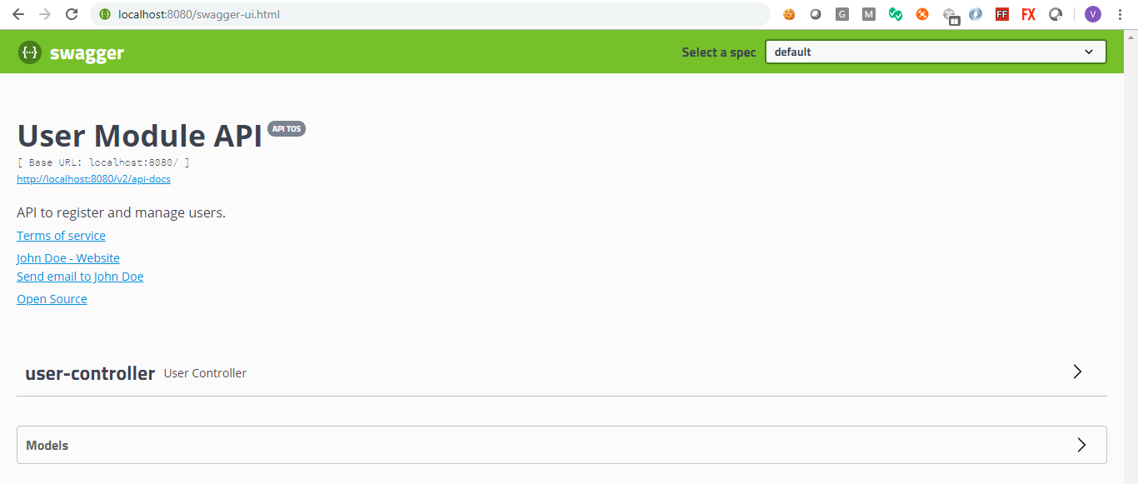
Let's try Swagger
Check API Documentation in Swagger by hitting http://localhost:8080/swagger-ui.html

Slide 83
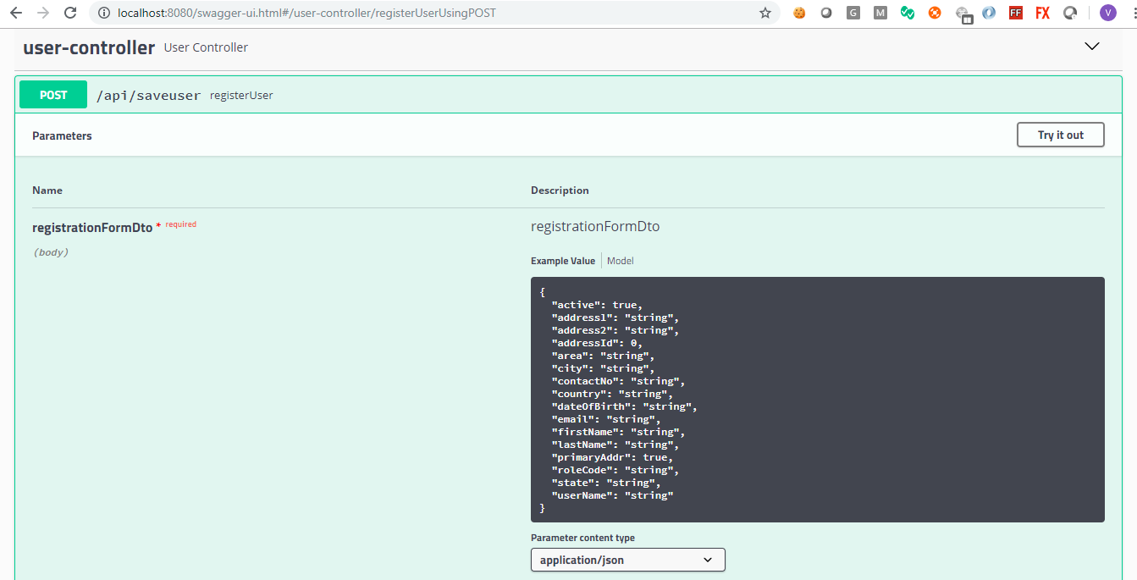
User Controller in Swagger - Request

Slide 84
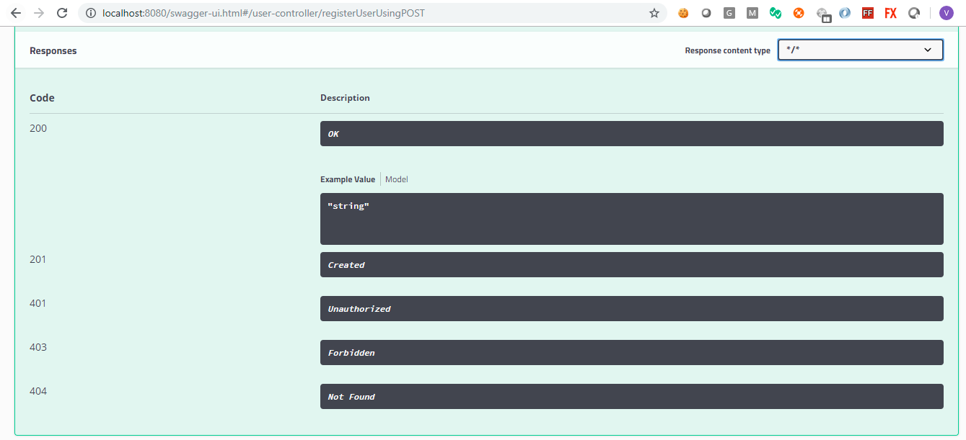
User Controller in Swagger - Response

Slide 85
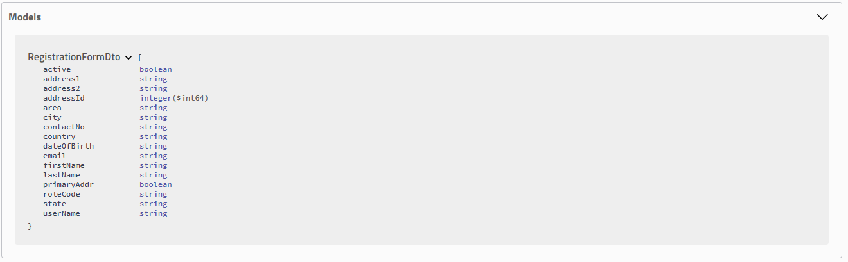
RegistrationFormDto in Swagger

Slide 86
Consuming APIs through POSTMAN
API Interaction

Slide 87
POSTMAN
Postman is a great tool when trying to dissect RESTful APIs made by others or test ones you have made yourself.
It offers a sleek user interface with which to make HTML requests, without the hassle of writing a bunch of code just to test an API's functionality.
All we have to do in order to test an API is to plug the route of the API into the address bar of Postman Application, select the Http Method Type (GET, POST, DELETE, PATCH, etc) on the dropdown box to its left, specify the format and content of requestBody (JSON, raw text, etc.) if needed and hit send.
Then, we get the response data in expected format with a http status code like 200 or 201, confirming the request was successful.
Additionally, we can also add headers, parameters, authorization, tests, etc. to our requests but we will not dig into those features in this tutorial.

Slide 88
Initialize User Roles in system
Before we test /api/saveuser end-point in Postman to save a user, we need to initialize user roles in our database. For this, we need to execute following steps:
Start POSTMAN application then select New -> Request
Enter request name as initializeroles
Enter request description (optional)
Select or create collection where to save request - we will create a collection called sbs (stands for spring-boot-sample) and select it.
The request is now created with GET method as its type.
Enter Request URL as localhost:8080/api/initializeroles
Hit Send button. Make sure, your spring boot application is running.
Analyse response by scrolling down the screen, you should get a success message.
You should also be able to see following User Roles in the system: Administrator, User and Moderator.

Slide 89
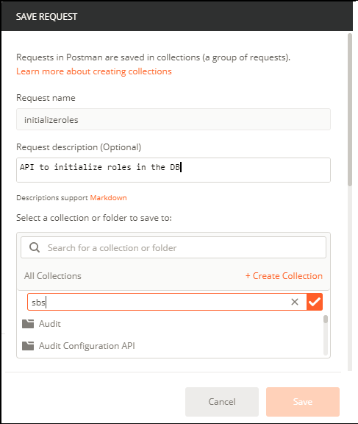
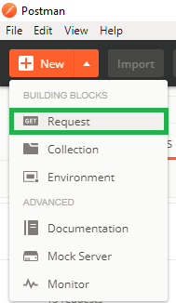
Create Request - Initialize Roles

Slide 90
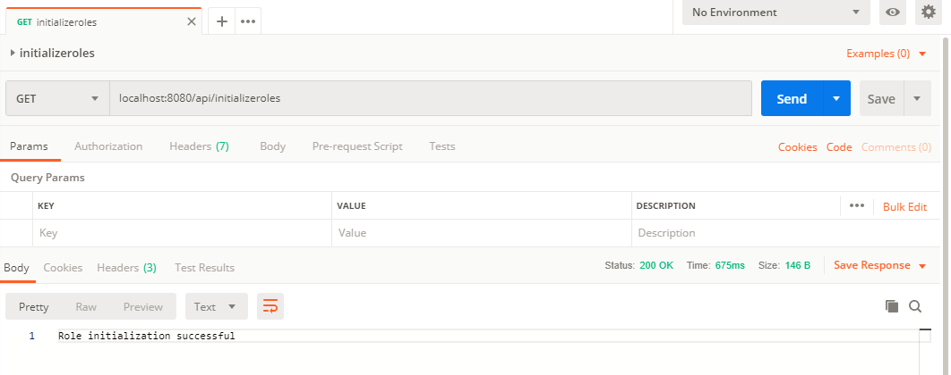
Postman Interface - Initialize Roles

Slide 91
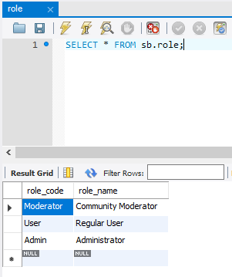
Roles Initialization - MySQL Workbench Output

Slide 92
Save User - Steps to Create and Test Request
To test /api/saveuser end-point in Postman, we need to execute following steps:
Start POSTMAN application then select New -> Request
Enter request name (this can match your actual end-point if you like)
Enter request description (optional)
Select sbs (stands for spring-boot-sample) collection to save request.
The request is now created, select POST as method type from dropdown.
Enter Request URL as localhost:8080/api/saveuser
Select Body Tab -> raw -> Text -> JSON (application/json)
Create a JSON Payload of RegistrationFormDto to be sent as Request Body in text editor (Payload example available in next slide).
Make sure, your spring boot application is running. Hit Send button.
Analyse response by scrolling down the screen and verifying User and Address creation as part of registration in Database.

Slide 93
Request Body Payload - Json format
{
"userName":"andy_smith",
"firstName":"Andy",
"lastName":"Smith",
"dateOfBirth":"07/04/1984",
"address1":"24, Adam Street",
"address2":"Turnpike Road",
"area":"Bay Side",
"city":"San Jose",
"state":"California",
"country":"US",
"contactNo":"+1-234-984-3465",
"email":"andy.smith@bootmail.com",
"active": true,
"primaryAddr": true,
"roleCode":"Admin"
}

Slide 94
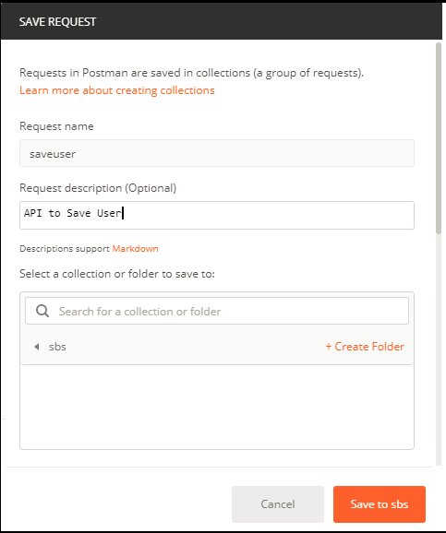
Create Request - Save User

Slide 95
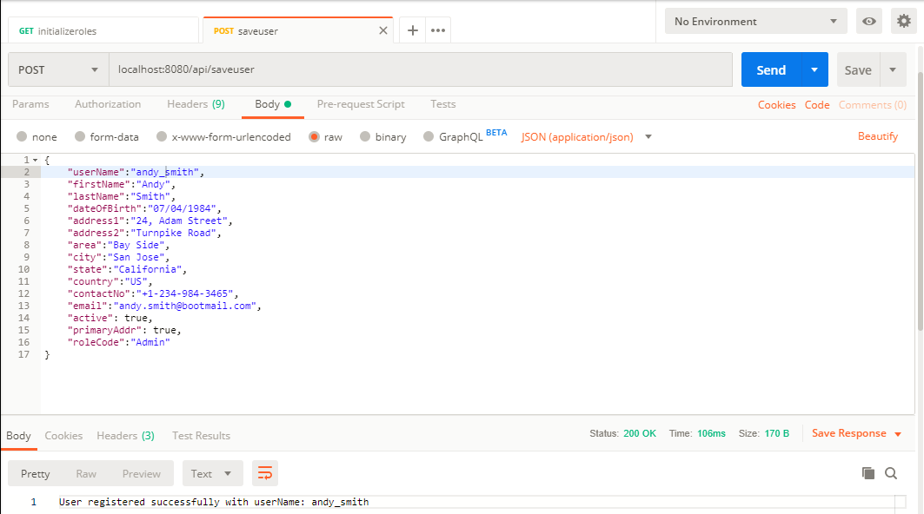
Postman Interface - Save User

Slide 96
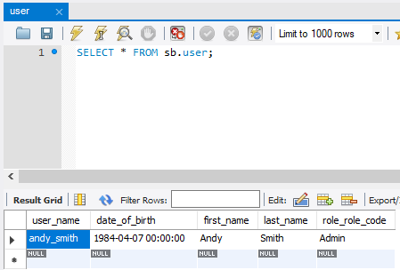
User - MySQL Workbench Output

Slide 97
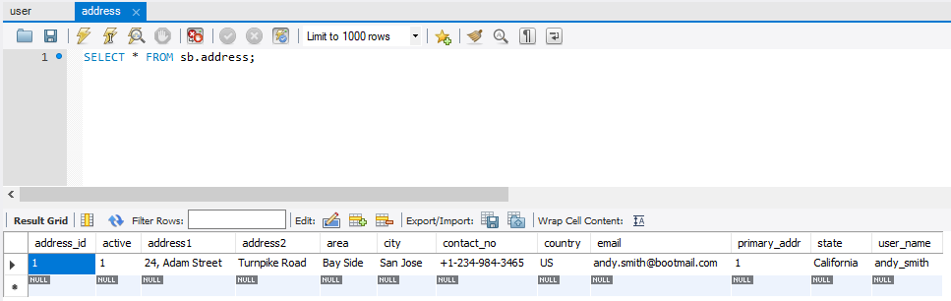
Address - MySQL Workbench Output

Slide 98
Concluding Notes

Slide 99
Concluding Notes
In this tutorial, we learned how to get started with Spring Boot Project and develop APIs in it.
We saw following Spring Boot specific features:
Spring Initializr
Spring Boot Application, Parent Starters and Autoconfiguration
Developed API in Spring Boot
Leveraged JPA Repository for Persistence Logic
We also learned about:
Custom Exceptions for business logic
Swagger for API Documentation
Postman to consume and test APIs
We developed and tested the end-points /initializeroles and /saveuser
Now, it is left upon audience to develop remaining end-points for which they can also refer to the code repository provided.

Slide 100

THANK YOU

